Slide 1
AWSA-EC2

Slide 2
EC2 - Elastic Cloud Compute
VMs in the cloud – boot new instances within minutes
EC2 purchase options
On demand – pay fixed rate
Reserved – 1 to 3 year terms for discount
Scheduled – available for specified schedule over 1 year term
Spot – allows you to bid for prices if you have flexible start stop times
Dedicated hosts – physical servers dedicated for use to single customer.
Dedicated instances – EC2 instances that are dedicated to a single customer
Capacity reservations – reserve capacity in an AZ for any duration
Notes:
On demand - you pay by the second
Reserved – If you have m4large on demand instance running, if you buy m4large reserved instance, the discount will apply, 20 instance limit per month, 1 -3 year term discount
Capacity - On-Demand Capacity Reservations enable you to reserve capacity for your Amazon EC2 instances in a specific Availability Zone for any duration, but no 1 or 3 year term

Slide 3
RI
For steady usage
Can pay upfront
Types
Standard – 75% cost saving
Convertible – 54% cost saving
Notes:
Convertible can be exchanged for another convertible instance
Standard: certain attiebutes cannot be changed during term, for e.g. instance type

Slide 4
Dedicated Hosts
Use case for regulatory requirements and licensing requirements
Can be purchased on demand hourly
Can be purchased as reservation with 70% discount

Slide 5
EBS – Elastic block storage
Virtual Disk
Placed in specific AZ, automatically replicated for protection
Root volumes – is where OS is installed
Types
SSD – General Purpose (GP2) – balances price and performance, up to 10000 IOPS, 3 IOPS per GB, burst to 3000 IOPS for extended for volumes at 3334 GiB
Provisioned IOPS SSD – more than 10000 IOPS, intensive apps such as noSQL DBs, can provision up to 20,000 IOPS per volume
HDD – throughput optimized, big data, log processing, data warehouse, cannot be boot volume
Cold HDD – lowest cost for infrequent access

Slide 6
Volume types
Instance store:
max size 10GB
EC2 can’t be stopped, rebooted or terminated only
Can’t update kernel RAM
EBS root device volume 1 – 2TB
Can be stopped
Can be modified on all EBS on the fly, except for magnetic
EC2 and EBS needs to be in same AZ. You can do this by taking snapshot of EBS, create a volume and change AZ
To move it cross region, you first take a snapshot of volume, copy snapshot cross region and then create a volume in new region
Migrate EC2 from 1 region to another – take snapshot, create image from snapshot or EC2, move AMI to region

Slide 7

Encryption
EBS, EFS, RDS all have to be encrypted while creating. For EBS, you can take a snapshot and encrypt it, when create a volume from it to encrypt it
S3 (buckets and objects) can be encrypted on the fly

Slide 8
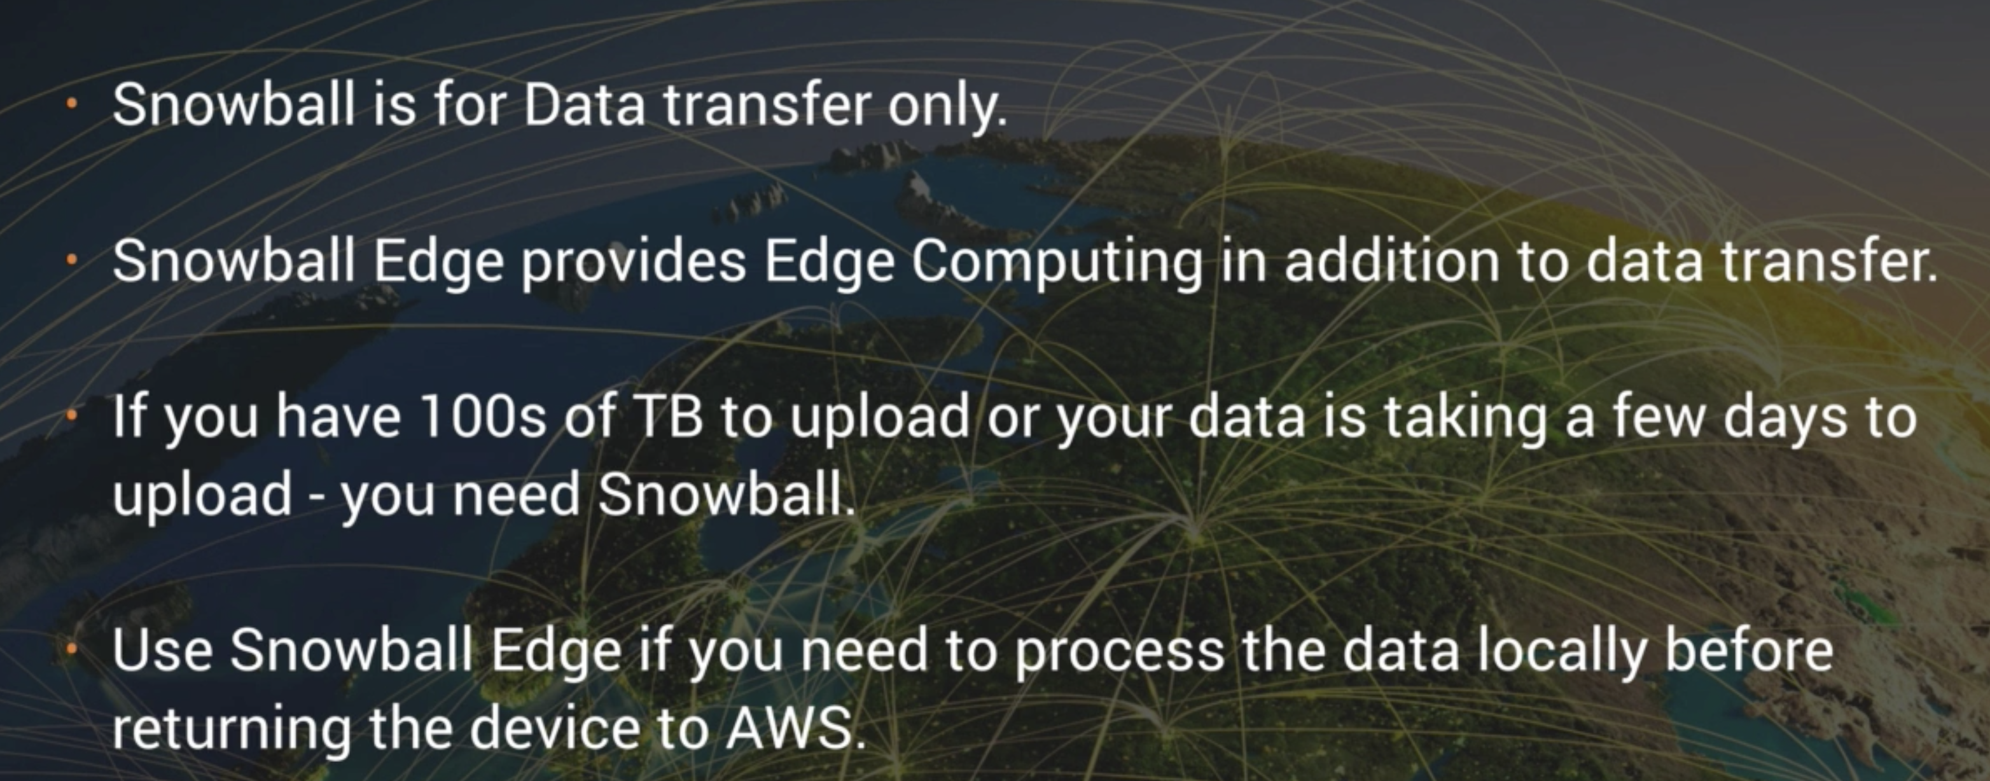
Snowball vs Snowball Edge

Slide 9
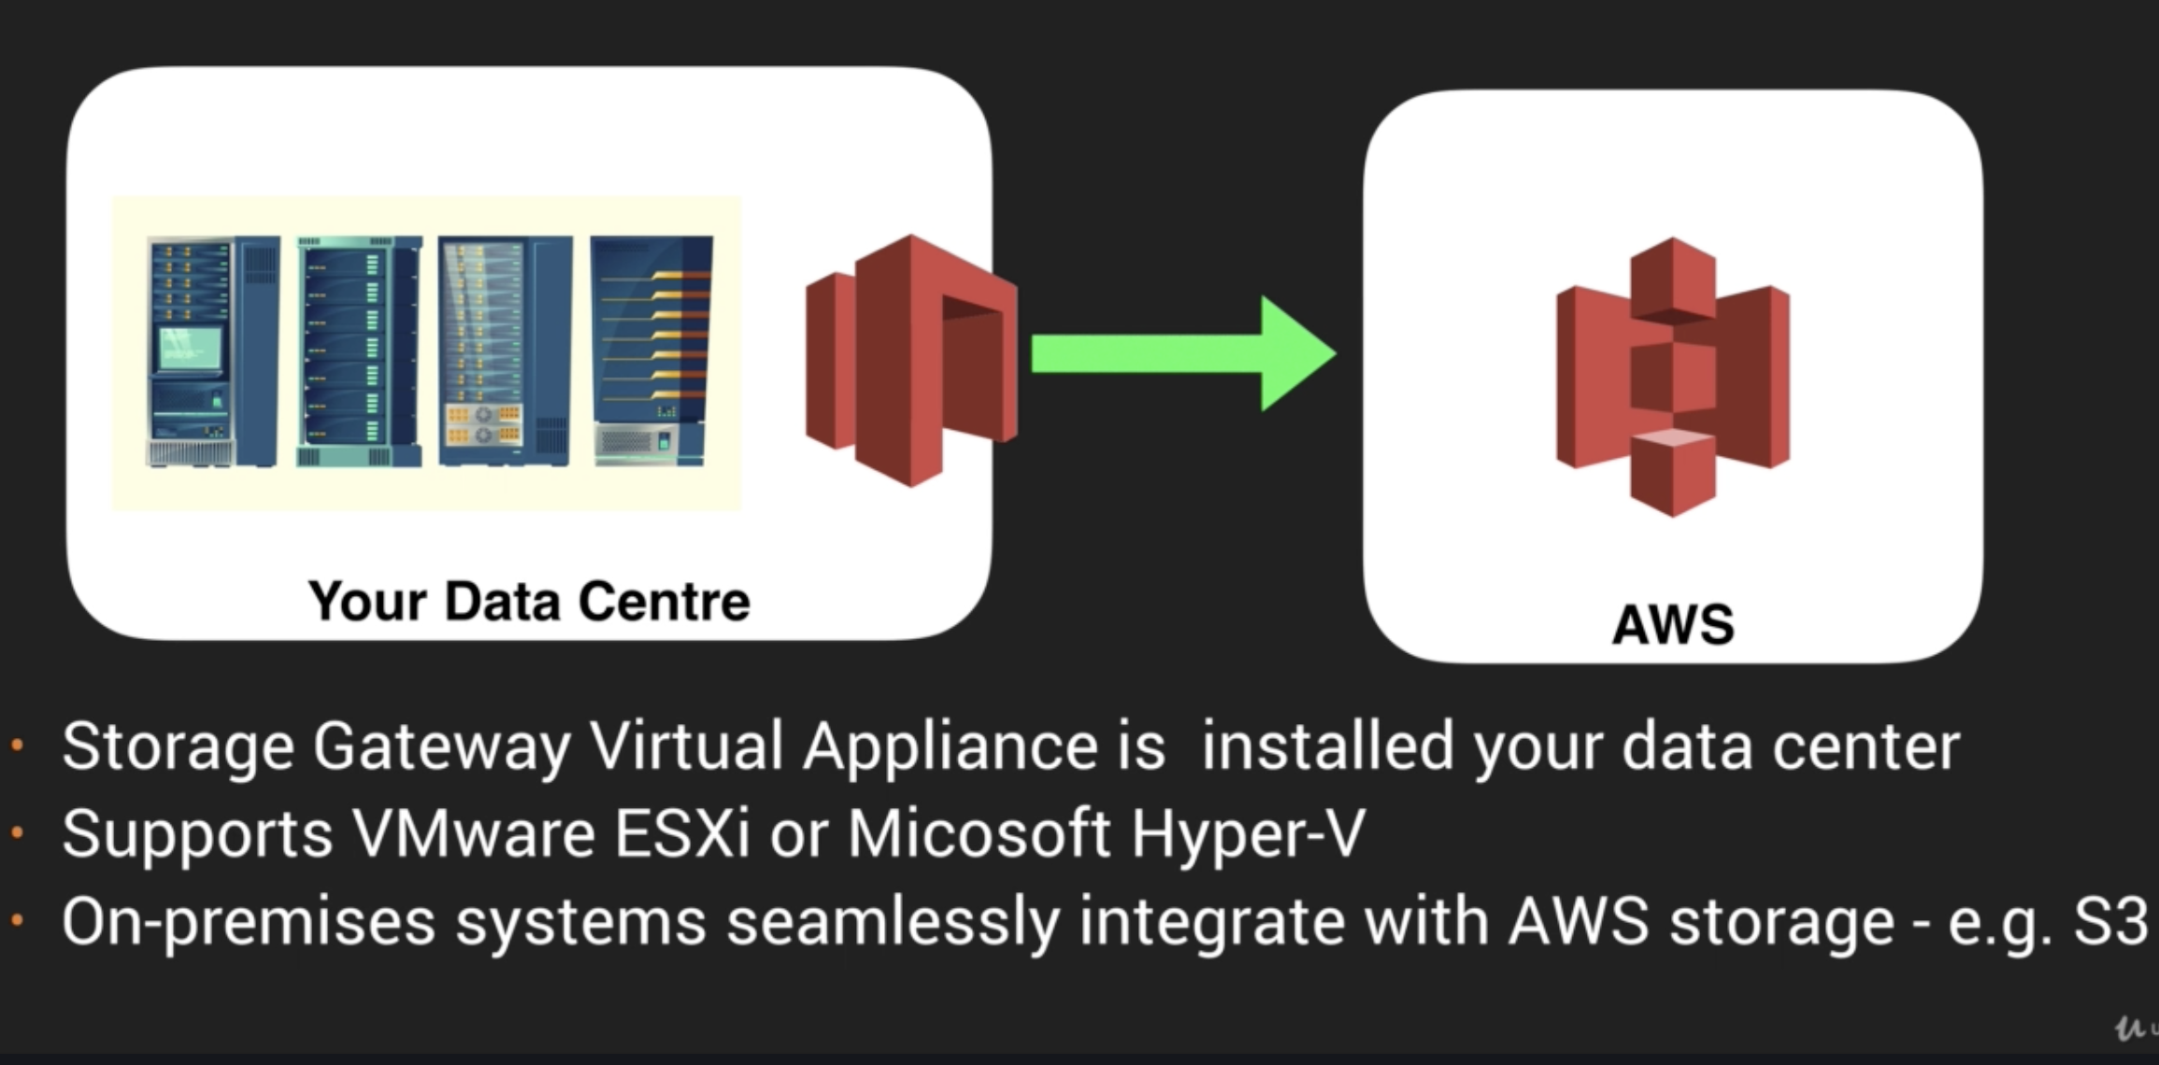
Storage GW

Slide 10
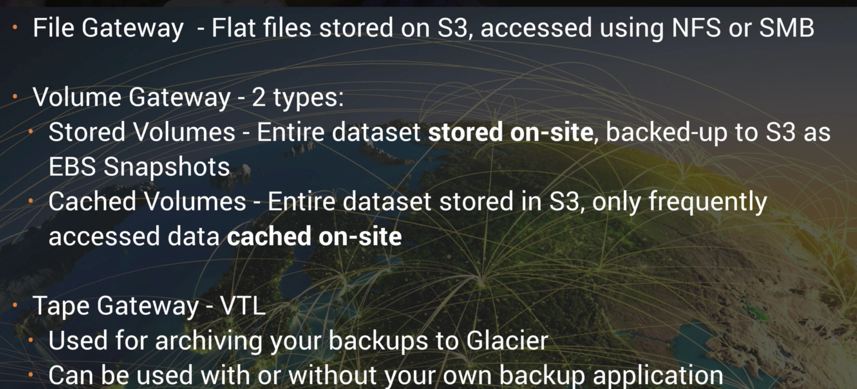
Storage GW

Slide 11
EC2
EC2 Termination protection is turned off by default
EBS volume deleted by default on termination
EBS root volumes can’t be encrypted (can be done using API), additional ones can be encrypted

Slide 12
Security Groups
Virtual Firewalls
Stateful – inbound rules automatically apply outbound rule
NACL – stateless, can deny access
All Inbound traffic blocked by default when new EC2 instance created
EC2s can have multiple SGs and multiple EC2s can be in an SG
SGs cannot specifically deny access

Slide 13
EBS – Elastic Block Storage
Virtual Hard Disks
Snapshots can be taken from Volumes
Images can be created from snapshots
EC2s can be spun up from images
Volume type, size can be modified on the fly, but AZ can’t be changed on the fly, for that snapshot has to be taken and volume created from it
Volumes are in same AZ as EC2, can’t exist in different Azs

Slide 14
EBS security
Snapshots of encrypted volumes are encrypted as well
Volumes from encrypted snapshots are encrypted as well
Snapshots can be shared if unencrypted

Slide 15
EBS Root volumes
Types
EBS backed – can be stopped, can be detached, and attached to different EC2
Instance store (ephemeral) – cannot be stopped, only terminated or rebooted, created from template stored on S3, less durable – will lose data on host failure. For non durable data, caches, large websites where data is living elsewhere
By default, both root volumes will be deleted on termination but with EBS backed you can disable this

Slide 16
ELB – Elastic Load Balancers
ALB – operates at layer7, HTTP, HTTPS, sticky sessions, TLS termination
Classic Load Balancer (ELB) – faster, lowest latency, HTTP, HTTPS (Secure HTTP), SSL (Secure TCP) and TCP
NLB – operate at Layer 4 of OSI, can use number of connections and round robin algorithm to balance load, extreme performance and static IP needed

Slide 17
ALB
For ALB/ELB you do not get IP address once created, you get a DNS
Supports HTTP, HTTPS, HTTP/2
TCP ports 1 – 65535
API
Classic ELB – aws elb describe*
ALB – aws elb2 describe*
Track request history – cloudtrail
Supports HTTPS termination
Load balance to classic ELB using classiclink (same region
Crosszone load balancing auto enabled
Message body - text/plain, text/css, text/html, application/javascript, application/json.

Slide 18
Cloudwatch
Monitoring service
Collects logs (insights), metrics (resource utilization, application performance), can create alarms, dashboards
Integrates with IAM, can create role to give certain users who assume the role access to cloudwatch data. You can’t give access to specific resources.
Logs – real time monitoring and indefinite (long term), cloud watch agent supports ability to monitor logs, agent integrates with IAM role
GetMetricStatistics API can be used to retrieve metric data beyond retention period, max retention 15 months, metrics can be stored at 1 second granurity
Cannot delete metrics

Slide 19
Events – stream of system events, targets can be set (for e.g. lambda function)
Alarms – alarm to monitor any metric, lasts 14 days

Slide 20
IAM roles and EC2
Can be attached on creation, and later too both from console and with API
1
Can only attach 1 role to an EC2
2

Slide 21

Bootstrap scripts
Advanced settings – userdata

Slide 22
EC2- metadata
Curl http://169.254.169.254/latest/meta-data/ will return meta data associated with EC2 for e.g. public IP

Slide 23
Autoscaling
Need to configure launch config before ASG can be created
Launch config – is an instance config template used to spin up instance
ASG – can specify number of instances, health check to ELB or EC2, criteria for scaling
Launch config is different than launch template – templates has versioning

Slide 24
Placement Groups
Placement Groups (PG) – recommended for apps that need low network latency, high network throughput, or both
Types
Clustered PG – grouping of instances within single AZ. Can only launch certain instance types in clustered PG
Spread Placement group – instances on distinct hardware and spread AZ. Can add 7 in each AZ
Partition -
Homogenous instances recommended in PG, can’t merge PG, can’t move existing instance in PG, need to stop instances before adding PG

Slide 25
EFS
Elastic File System – mounts file systems which can be shared by multiple EC2s

Slide 26
Lambda
Run code without managing servers, simply run code, serverless
Stateless but state can be managed using other services such as S3
Triggers
Languages – Node, Python, Java, Ruby, C#, Go, Powershell
500MB scratch space
Lambda function can run 1 min – 15 minutes

Slide 27
More stuff

